Slide 1
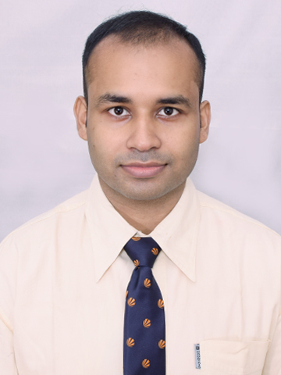



Anirban Adhikary
Analyst/Software Engineer
Bachelor of Computer Applications
2015 – 2018
Masters of Computer Applications
2019 - 2022
Mumbai
Skills
anirban.adhikary@capgemini.com
Java 8 | Java Basics, OOPS, Generics, Collections, Arrays, Loops, Lambda Exp, Stream API Junit, Mockito
Spring core | IOC & Dependency Injection, Autowire
Spring REST | REST controllers, Implementation of GET, POST, PUT & DELETE, Bean Validation & Exception Handling, Testing Services, Controller & Repository layer
Spring Data MongoDB | Implement DAO layer using Mongo Repository
Spring Data JPA | Implement DAO layer using spring Data repositories
Spring Boot Microservices | Spring Boot Starters, annotations, Messaging Service, Sync/Async comms, Swagger API documents
Spring Cloud | Eureka, Feign Client, Netflix Hystrix
React | Components, Hooks, Event handling, Redux, Reducers, Material UI
Database | MongoDB My SQL Basics
UI Tech | HTML 5 & CSS 3,JavaScript, ES6 & TypeScript Reusable templates, Optimized UI Designed
Tools | Git, Postman, Maven, IDE
Add On skills | Communications, Team management. Peer learning, Logical Reasoning and Data Interpretation, Analytical Skills
+91 7686031836
A4
Full Stack Developer
Hands on experience in creating microservices with Springboot, Spring Security, Spring Cloud API Gateway, Eureka server, load balancing, Feign
Proficient in creating Single page Web Application in React with Authentication with route guards, Material UI, Bootstrap, Redux.
Hands on experience in implementing polyglot architecture with spring boot
Experience in creating documentation with swagger and in unit testing using Junit, Mockito including code quality compliance using Sonar cube
Experience in working with MongoDB and MySQL databases
E-Commerce Shopping Cart Application
Completed end to end case study of Shopping Cart Application along with JWT authentication, Swagger and payment testing using RazorPay, responsive UI with React Material UI and Bootstrap, React used for user interface.
Project Name – LRS , Client Name – PENSKE
Key Responsibilities –
Developed and maintained the application. Worked on bug fixes. Documented important changes and new integrations.
Technology used in Project –
Spring Batch, Rest Apis, Mybatis, Oracle SQL, Spring AOP, Angular, Bit Bucket
Check out my work on GitHub & Video Profile

